Slide 1



Nils, Edgars, Allen, Thomas
Notes:
Notes: Agenda ? Thomas:

Slide 2

Agenda
1
Intro
Defining client and project scope
2
Our product
What is the data source and how can we utilize it for you
3
The analytical approach
Defining metrics to find the ideal players for the NBA
4
Advanced metrics
Deep-dive into advanced undervalued metrics and stats
5
Scouting report
Proposal for prospect countries and players to watch out for

Slide 3

Our client
Agency in the field of player scouting
Aims to identify European players for the NBA
Asked for information on potential countries & players in Europe to look at
Notes:
mention the most promising countries

Slide 4
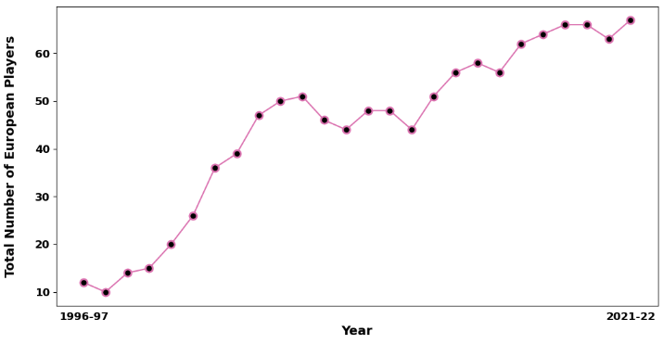
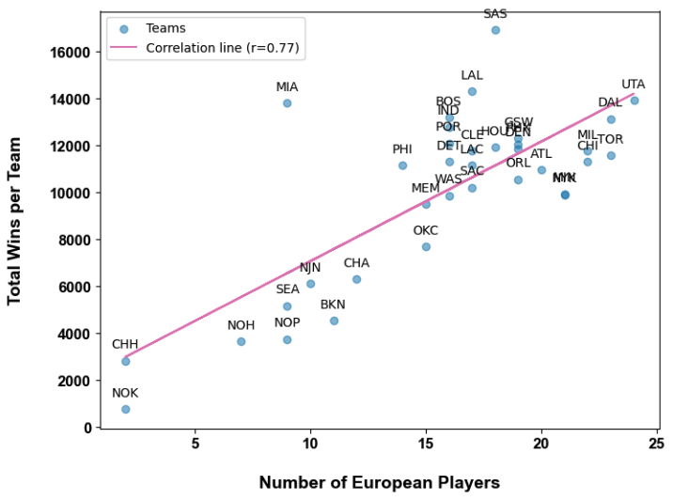
Why focus on European players?
The number of European players grew over the years
Europeans help NBA teams win games
x6

Slide 5
Our product
1
Intro
Who is Neat Scouting data and what can we offer to you
2
Our product
What is the data source and how can we utilize it for you
3
The analytical approach
Defining metrics to find the ideal players for the NBA
4
Advanced metrics
Deep-dive into advanced undervalued metrics and stats
5
Scouting report
Proposal for prospect countries and players to watch out for

Slide 6
Our product
Highlights statistical differences where Europeans players stand
Identifies geographical areas in Europe to look out for
Provides an easy to use dashboard to identify prospect players
Notes:
Highlights statistical differences in NBA metrics
where European players stand out vs. non-European players
Identifies geographical areas in Europe to look out for
Provides a list of player profiles per relevant area / country
Focuses purely on professional player in a European leagu
It explicitly exclude US players, playing in one of European leagues

Slide 7

Our data set
Player Stats X
Standout
metrics
League X
Player Stats
Player Profile X
Player Profile
NBA Stats
Euro Stats
nba.com
basketball.realgm.com
Index data
League Z
Player Stats Y
Advanced rebounds
Biometrical index
Player Profile Y
Notes:
mention that icons are tables that we’ve merged

Slide 8
The analytical approach
1
Intro
Who is Neat Scouting data and what can we offer to you
2
Our product
What is the data source and how can we utilize it for you
3
The analytical approach
Defining metrics to find the ideal players for the NBA
4
Advanced metrics
Deep-dive into advanced undervalued metrics and stats
5
Scouting report
Proposal for prospect countries and players to watch out for

Slide 9
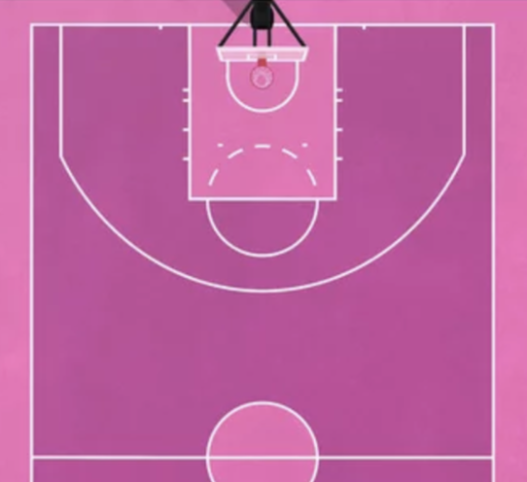
Player Profiles
Guard
Forward
Center
Forward
Guard
Center

Slide 10
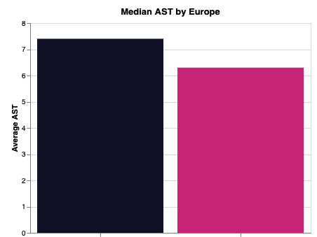
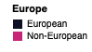
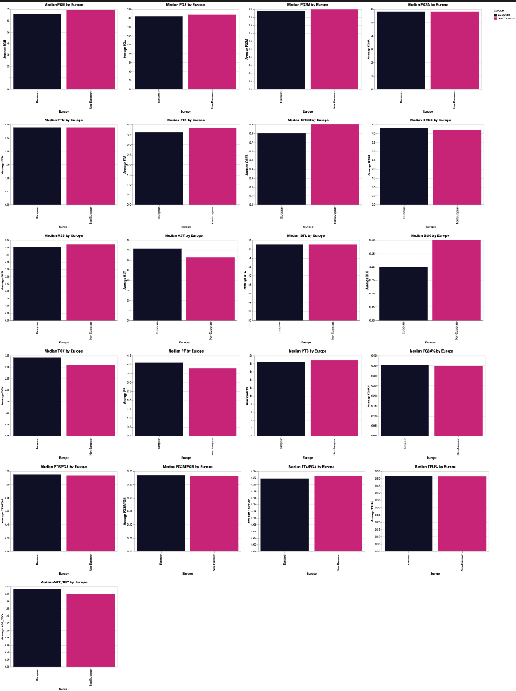
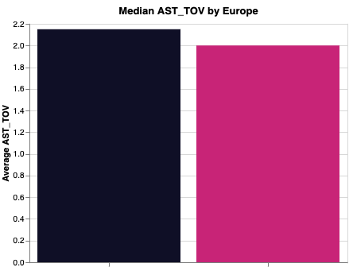
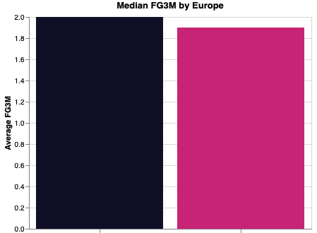
Standout metric approach (Guard)
Overall Stand-Out Metrics
Playmaking Ability
Assists
→ AST
Handling Basketball
Assists/Turnovers
→ AST/TOV
Shooting Ability
3-Point Field Goals Made
→ FG3M

Slide 11
Standout metrics - Guard
6.3
avg. Assists
2.1
1.98
avg. 3-point field goals made
Assists / Turnovers

Slide 12
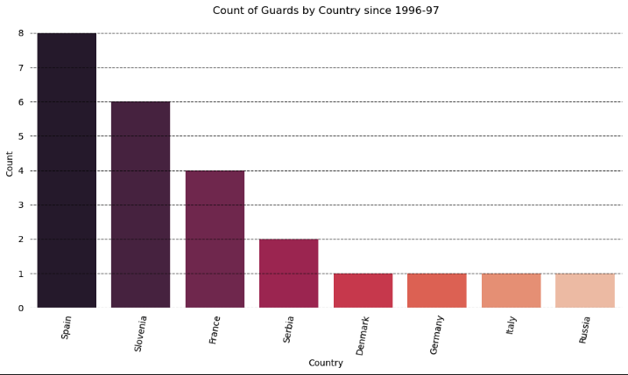
Where do the best Guards come from?

Slide 13
Stand-out metrics - Center
13.0
AVG Rebounds
2.0
3.0
AVG Blocks
AVG Assists

Slide 14
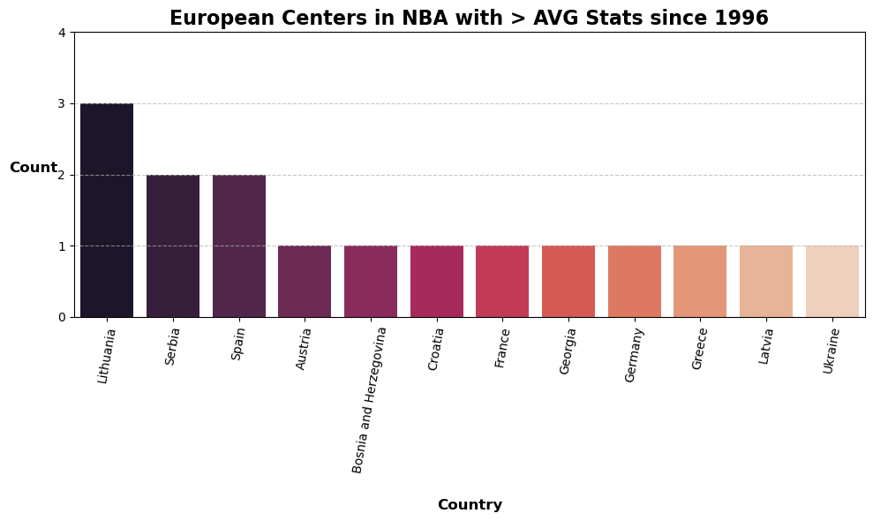
Where do the best Centers come from?

Slide 15
Stand-out metrics - Forward
30 %
35 %
3.0
AVG 3-pointers made vs field goals made
AVG 3-pointers
attempted
AVG Assists

Slide 16
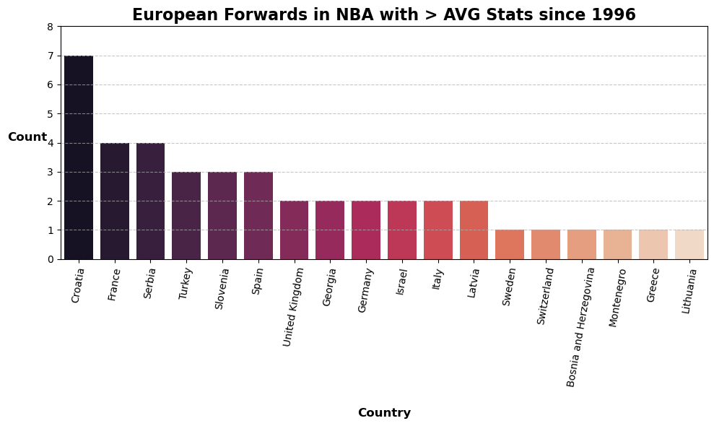
Where do the best Forwards come from?

Slide 17
Advanced metrics
1
Intro
Who is Neat Scouting data and what can we offer to you
2
Our product
What is the data source and how can we utilize it for you
3
The analytical approach
Defining metrics to find the ideal players for the NBA
4
Advanced metrics
Deep-dive into advanced undervalued metrics and stats
5
Scouting report
Proposal for prospect countries and players to watch out for

Slide 18
Advanced metrics
Contested Rebounds
European Centers have more contested rebounds
Consistency
Europeans are more consistent
Secondary Assists
European Guards score higher for Secondary Assist
Notes:
Hello friends and enemies

Slide 19
AVG Height per position
 | Center | Forward | Guard
Europe | 2.13m | 2.06m | 1.95m
Rest of World | 2.11m | 2.03m | 1.91m
Notes:
A difference in height is significant.

Slide 20
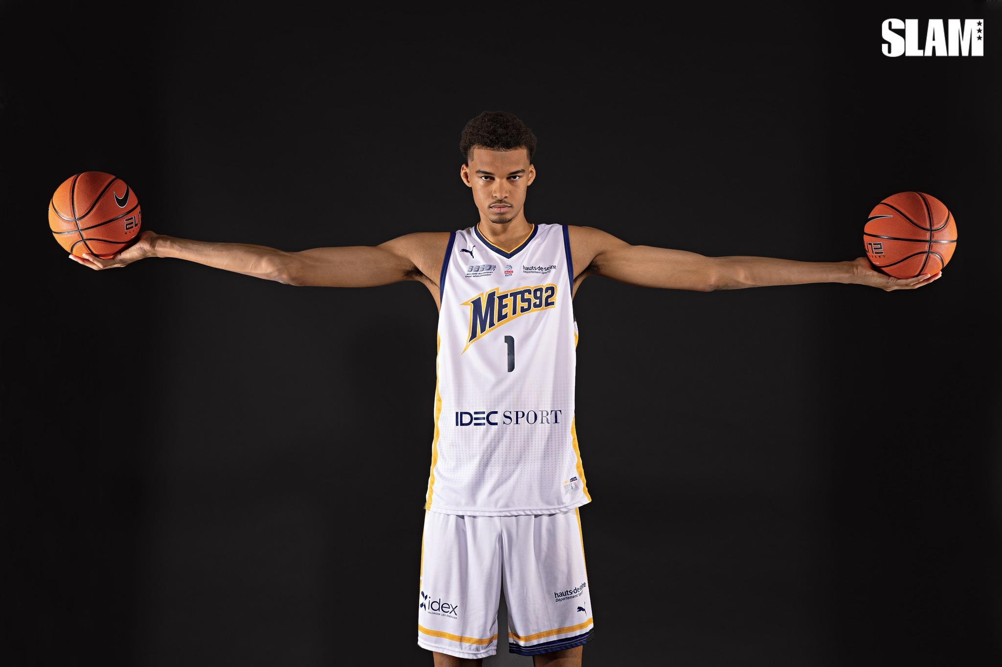
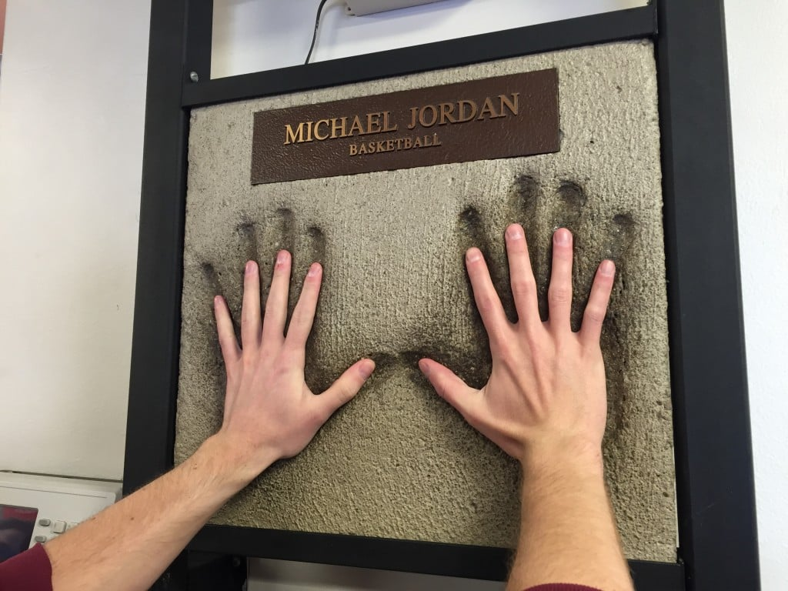
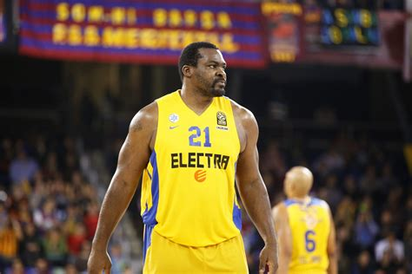
Expectations to derive further findings
Data on NBA.com earliest from 2013
Dealing with missing data
Using smaller sample for inferring, however no data availability in the European dataset
Wingspan
Hand size
Upon instructions from clients we will investigate further European data sets for biometrical data
Weight

Slide 21
Scouting report
1
Intro
Who is Neat Scouting data and what can we offer to you
2
Our product
What is the data source and how can we utilize it for you
3
The analytical approach
Defining metrics to find the ideal players for the NBA
4
Advanced metrics
Deep-dive into advanced undervalued metrics and stats
5
Scouting report
Proposal for prospect countries and players to watch out for

Slide 22

Scouting Report

Slide 23

Thank you
100+
xxxxx
xxxxxx

